Slide 1
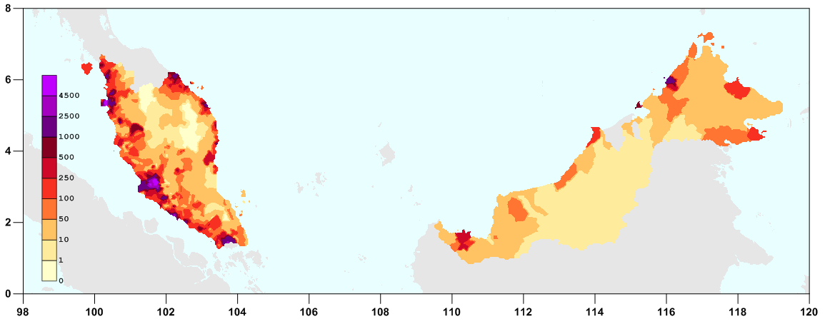
Review of “Can Malaysia Escape the Middle Income Trap?” By Shahid Yusuf & Kaoru Nabeshima World Bank Development Research Group 2009
Nathan Hutson

Slide 2
Background on Malaysia
Current classified by World Bank as an “Upper Middle Income” country
30 Million population with GNI per capita of $11K (similar to that of Brazil)
Very diverse (ethnic, linguistic and religious)
Net exporter of finished electronics and natural resources
GPD consistently posts 4-6% annual growth

Slide 3
Approach of the Article
Focuses on Penang – a highly industrialized and educated region in the northwest of the country that accounts for almost have of Malyasia’s electronics exports
In Penang - increased exports have driven wage growth
However, this growth is potentially undermining competitiveness for traditional electronic manufactures
Question of how to move up the value chain to higher value added products
Authors warn that eventually, Penang’s comparative advantage in manufacturing will begin to fade, so it should look for new opportunities before this happens

Slide 4
Malaysia’s Fork in the Road
While investment by Multi-nationals has been good for Malaysia, the country cannot rely on investment by multinationals directing the path toward developed status.
“Diversification into product lines which leverage expertise in current lines of business. For example, electronic and IT equipment for medical purposes are possibilities, as are biopharmaceuticals although growing a profitable biotech subsector is a far more demanding proposition”
Malaysia currently does not have the depth of skills to develop new industries at significant scale

Slide 5
Revealed Comparative Advantage
RCA basically shows which products are disproportionately exported by a country vis-a-vis its total export portfolio
It differs from the traditional approach of measuring Ca by measuring actual export performance rather than assessing the underlying sources of comparative advantage
Looking at the pattern of exports, the authors demonstrate that the importance of electronics has been growing, while the importance of natural resources has been falling
“Increasingly, Penang’s comparative advantage appears to be in high-tech products, especially electronics, telecommunication equipment, and computer-related products, mostly produced in plants owned by MNCs.”

Slide 6
Weaknesses of RCA Analysis
It is backward looking – does not tell what a country should do in the future
Does not look at sustainability of current practices
May understate the role of intra-industry trade
Would not differentiate between true comparative advantage versus exports from subsidized industries

Slide 7
Moving up the Value Chain
PRODY value – marker of sophistication of exports
EXPY – weighted average of PRODY
Tends to correlate with GDP per capita
EXP Y -measure of the productivity level associated with a country’s specialization pattern
In general, assumption that middle income countries should target the categories of products that rich countries export
“Countries become what they produce” (Rodrik)

Slide 8
Potential Cause of Malaysia’s Trap
Building upon existing CA, not “accumulating capabilities” to branch out to higher value added
Penang – Narrow band of export products
“Density" - defined as a new product’s proximity to a given country’s current set of products and how easy it is to move into that new product
China has revealed comparative advantage in one third of the products its exports, for Penang it was only 12% in 2007
As Malaysia’ production of key electronic commodity types increases, it’s comparative advantage in these existing product types may fall

Slide 9
How to address this issue?
Penang could build up capability to export products for which it does not currently have (Upgrade)
It must be cognizant of limitations inherent in its “product space”, i.e. it is easier to diversify into new product types that have overlap with existing products that it competitively produces already
“Density" - defined as a new product’s proximity to a given country’s current set of products and how easy it is to move into that new product

Slide 10
Diversification
Could also move into completely new product areas
Rather than doubling down on electronics, could move into primary products, agro-based products, and other resource-based products, and moving in high tech like biotech
Constrained by 1) low agglomeration economies 2) poor local research base 3) the quality of the technical workforce 4) Absence of capable Malaysian firms
In some cases it may be possible to take advantage of knowledge spillovers from MNC’s however, typically spillovers from FDI are modest

Slide 11
Investment in R&D
Should improve research capability of local universities
The ratings of recent university graduates tend to be passable but not excellent
Should not place all eggs in the university basket as most patents are filed by firms rather than universities, even in the US
Currently a mismatch between the skills and services firms need and what universities can provide
Post-doctoral programs might help to bridge the divide

